Slide 1


Lesson 13 The boy who cried wolf
UNIT 3

Slide 2
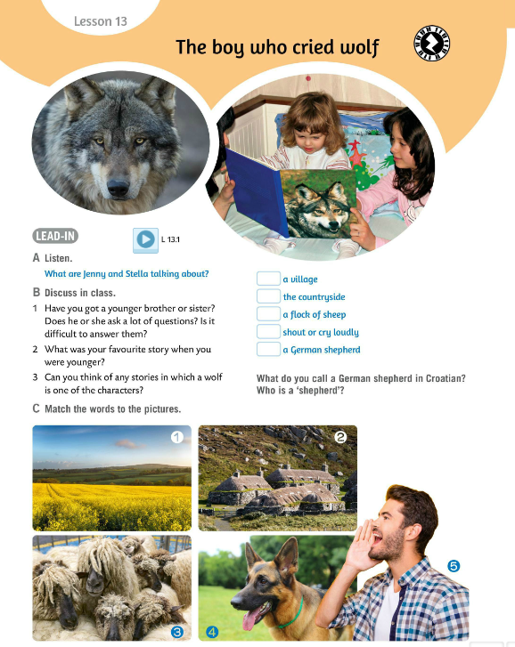

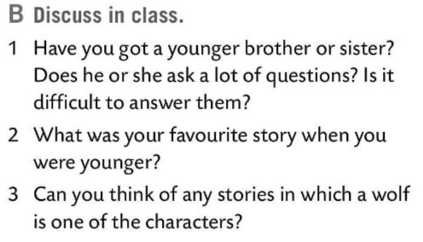

Listen to the recording. Answer the question from Task A.
What are Jenny and Stella talking about? Listen and find out.
Jenny and Stella are talking about what happened to Emma and why mum was angry with Emma.
Discuss in class questions from Task D.
Read the questions, think of an answer and share it with the class.

Slide 3
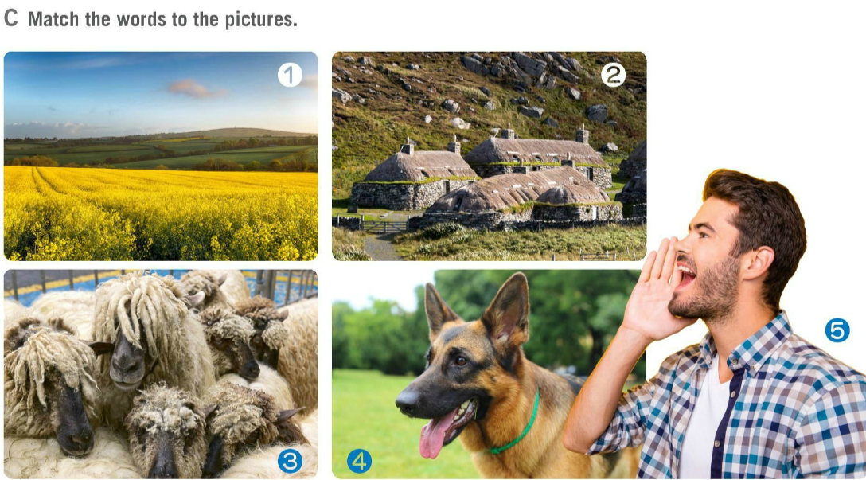
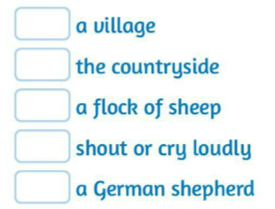
Match the words to the pictures in Task C.
Check.
Translate:
a village – selo
the countryside – priroda
a flock of sheep – stado ovaca
shout or cry loudly – zavikati
a Greman sheperd – njemački ovčar
2
a fable – basna
a fairy tale – bajka
Can you name fairy tales that have wolves as characters?
1
3
5
4

Slide 4
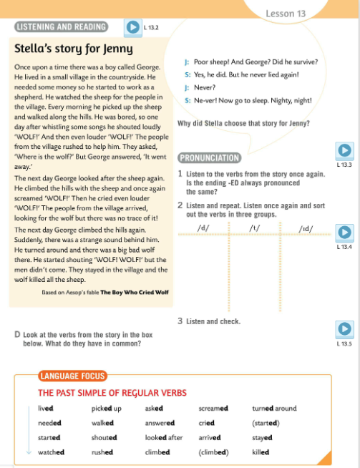
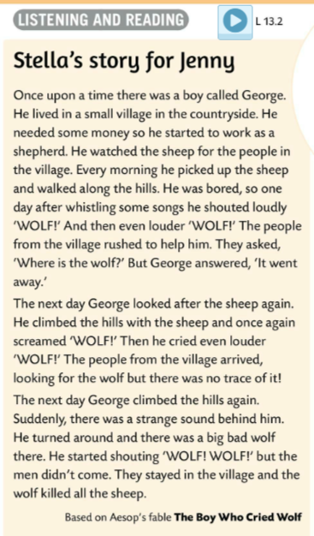
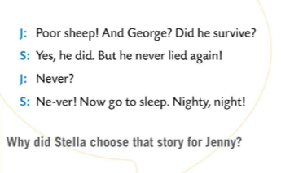
Listen to Stella’s story for Jenny.
Read the story. Underline new or unfamiliar words.
Check the words with your tecaher.
Why did Stella choose that story for Jenny?
Stella chose this story to teach Jenny not to tell lies. Also, to show Jenny what happens to people who tell lies.
Have you ever heard about Aesop? Aesop was a Greek slave famous for his fables and storytelling.
In pairs do more research on Aesop and some of his most famous fables. Present your research in class.

Slide 5
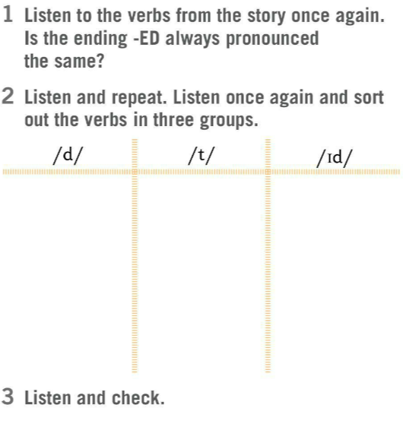
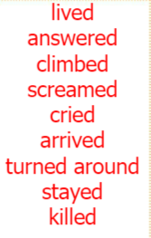
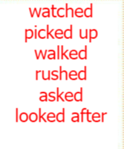

Listen to the verbs from the story again. Is the ending –ED always pronounced the same?
Listen and repeat.
Listen once again and sort out the verbs in three groups.
Listen and check.

Slide 6
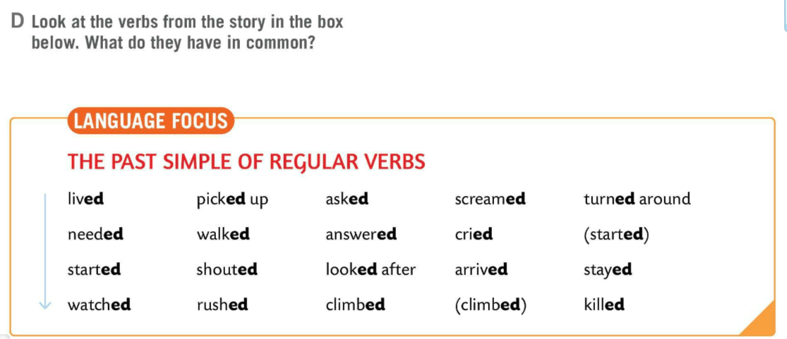
Look at the verbs from the story in the box. What do they have in common?
LANGUAGE FOCUS
Past simple is used for past events that are finished.
Glagolsko vrijeme past simple koristimo za opisivanje prošlih događaja.
The simple past of regular verbs is formed by adding -ed to the infinitive of the verb.
Past simple pravilnih glagola tvorimo tako što se infinitivu doda nastavak –ED.
e.g.
scream → screamed
¸need → needed
ask → asked

Slide 7
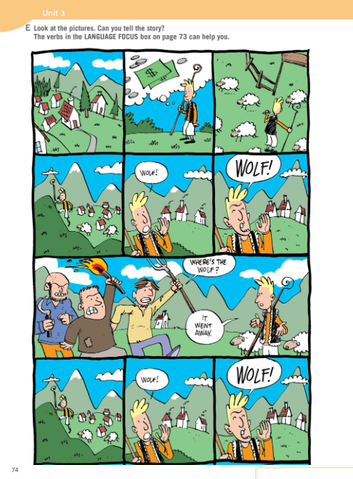

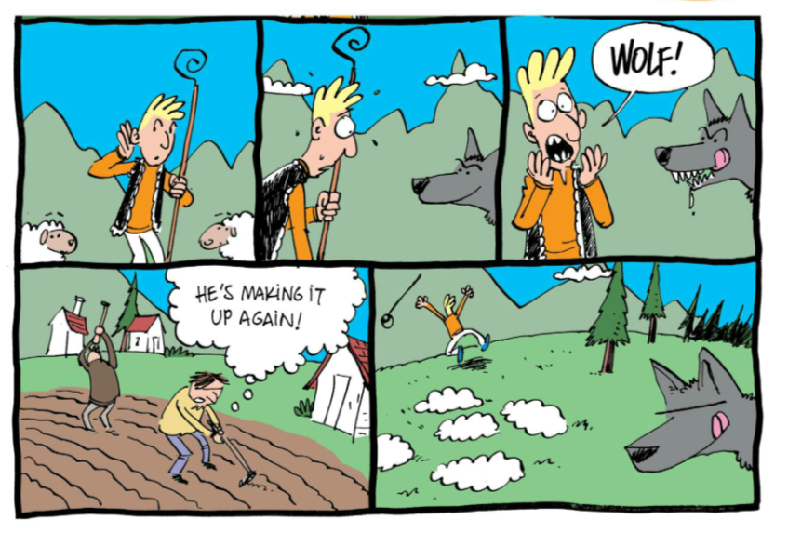
Look at the pictures in Task E. Can you tell the story?
The verbs in the LANGUAGE FOCUS box on page 73 can help you.

Slide 8
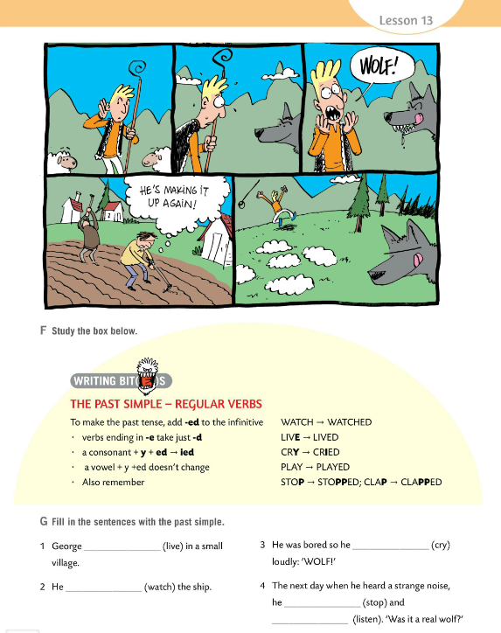
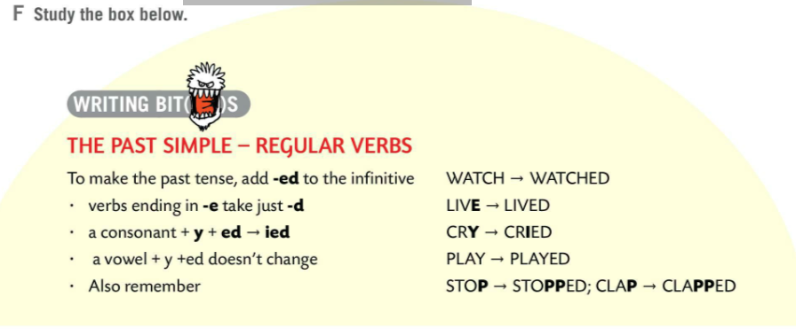
WRITING BITES
There is a set of spelling rules that we have to remember.
verbs ending in –e take –d
live → lived
a consonant + y + ed → -ied
cry → cried
a vowel + y + ed - doesn’t change
play → played
double the last consonant
stop → stopped
clap → clapped
travel→travelled

Slide 9
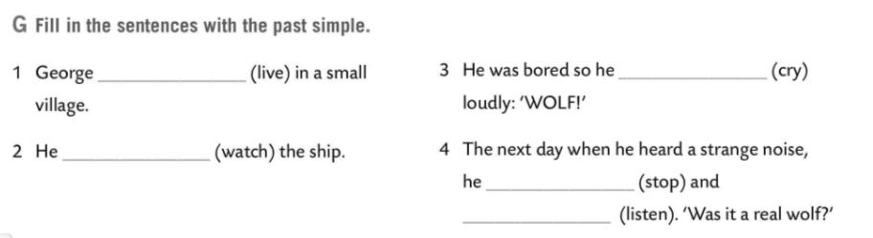
Fill in the sentences in Task G with the past simple.
Check.
lived
cried
watched
stopped
listened

Slide 10
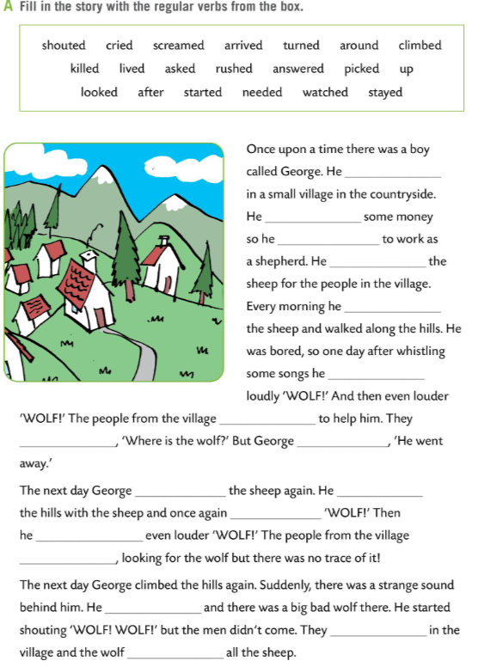
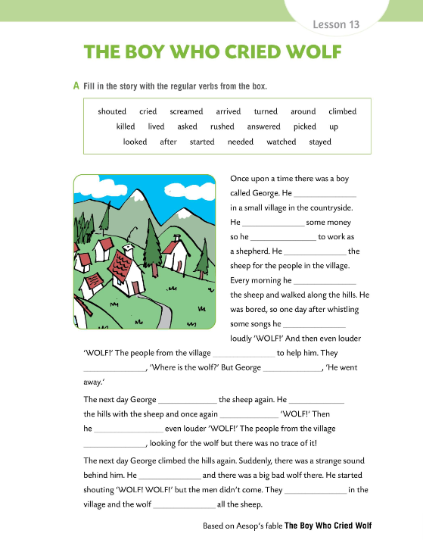

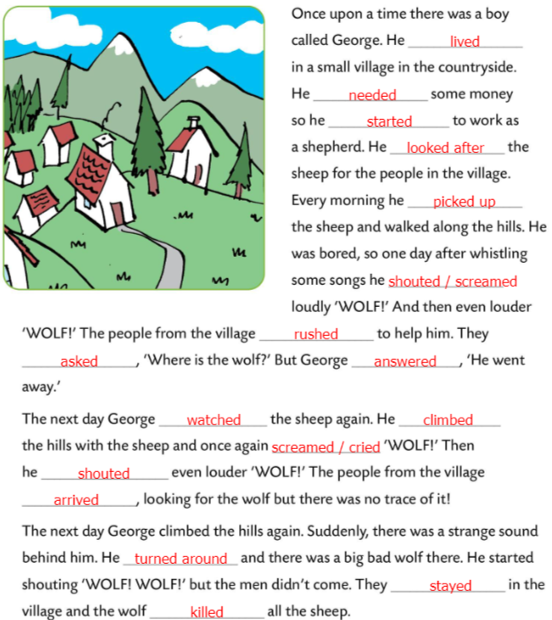
Workbook page 67.
Fill in the story with the regular verbs from the box in Task A.
Check.

Slide 11
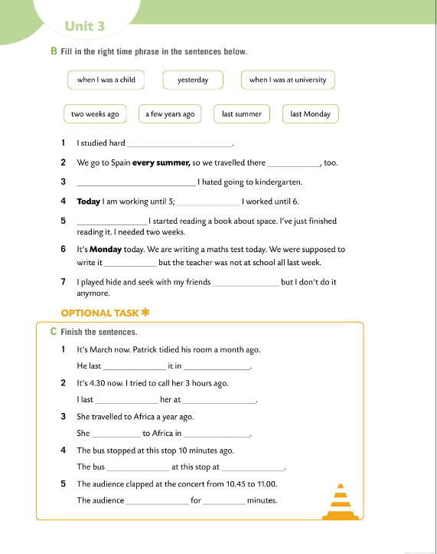
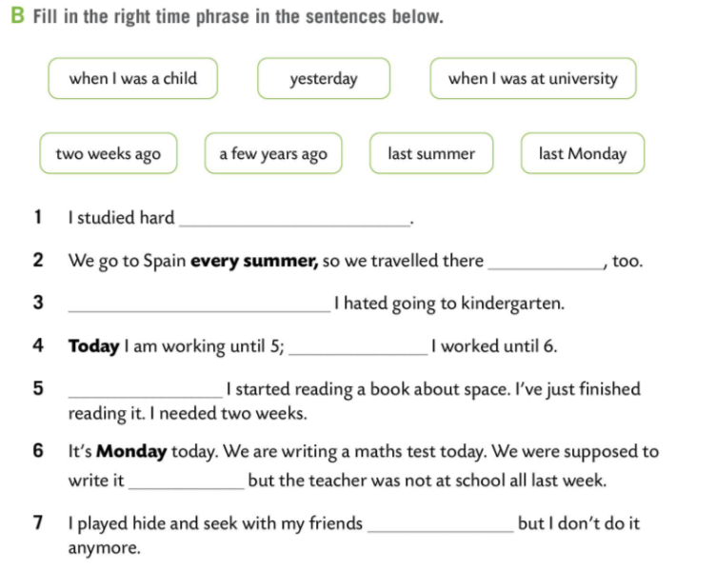
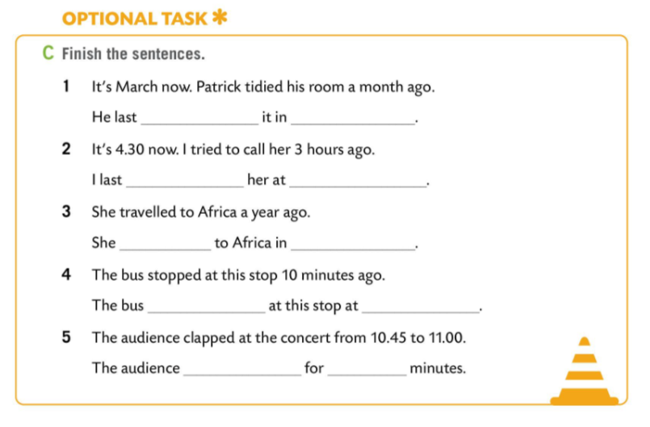
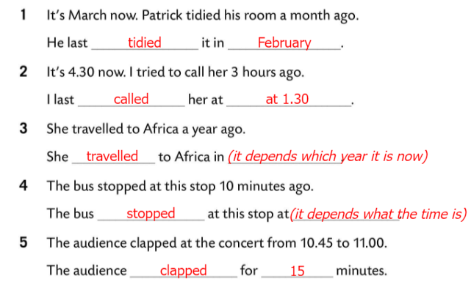
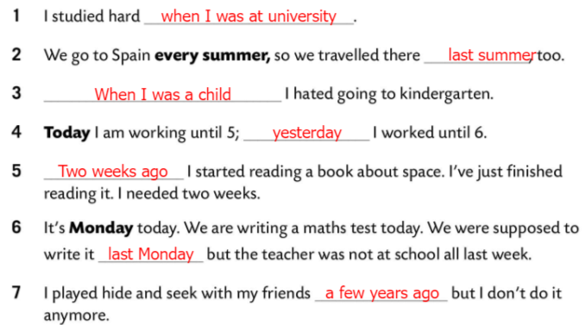
Workbook page 68.
Fill in the right time phrase in the sentence in Task B.
Check.
Finish the sentences in Task C.
Check.

Slide 12
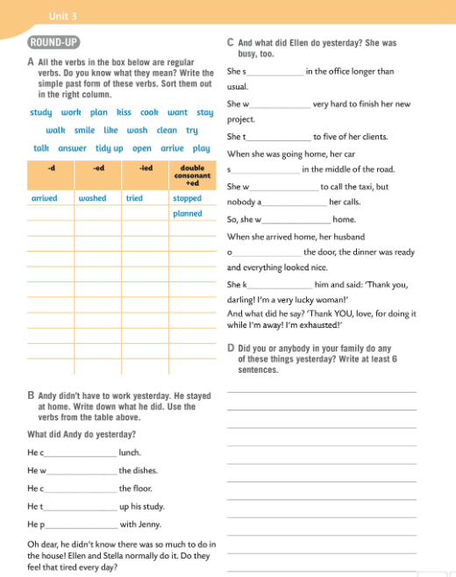
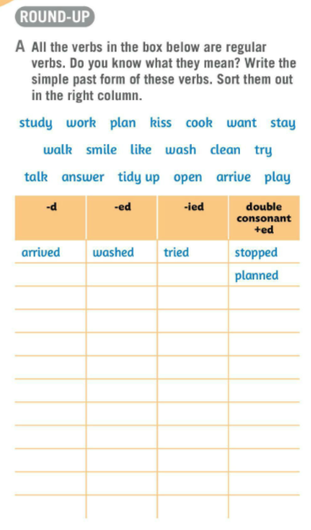
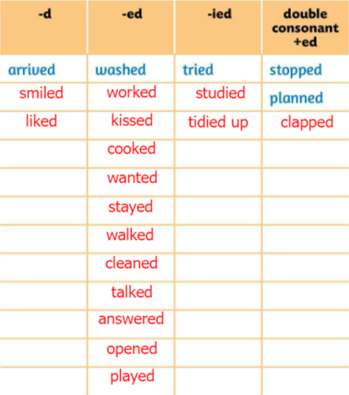
Let’s revise!
All the verbs in the box in Task A are regular verbs. What do they mean?
Write the simple past form of these verbs.
Sort them out in the right column.
Check.
study – učiti smile – smiješiti se
work – raditi like – sviđati
plan – planirati wash – prati
kiss – poljubiti clean – čistiti
cook – kuhati try – pokušati
want – htjeti talk – pričati
stay – ostati answer – odgovoriti
walk – hodati tidy up – pospremiti
open – otvoriti arrive – stići
play – igrati se

Slide 13
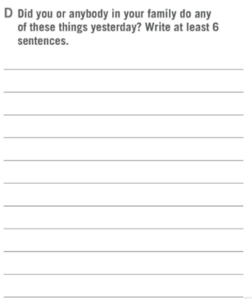
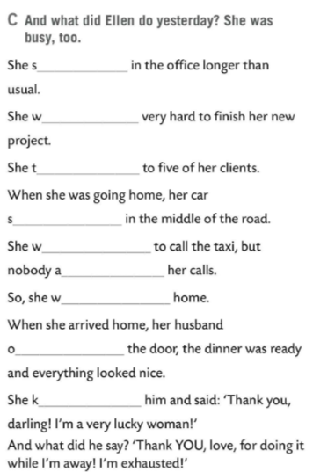
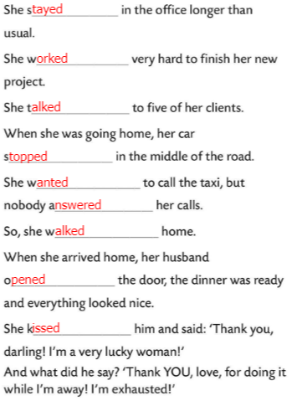
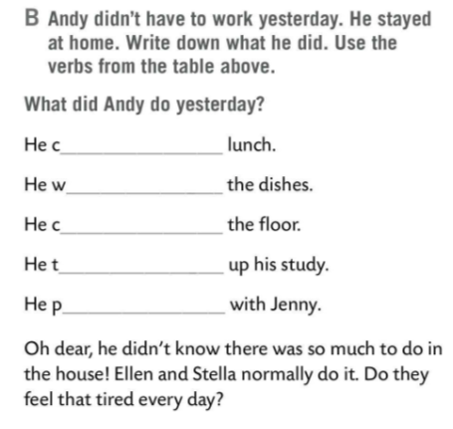
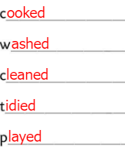
Andy didn’t have to work yesterday. He stayed at home.
Write down what he did. Use the verbs from the table above.
Check.
What did Ellen do yesterday? She was busy, too.
Fill in the sentences in Task C.
Check.
Did anybody in your family do any of these things yesterday?
Write at least 6 sentences.
Share your answers with the class.

Slide 14
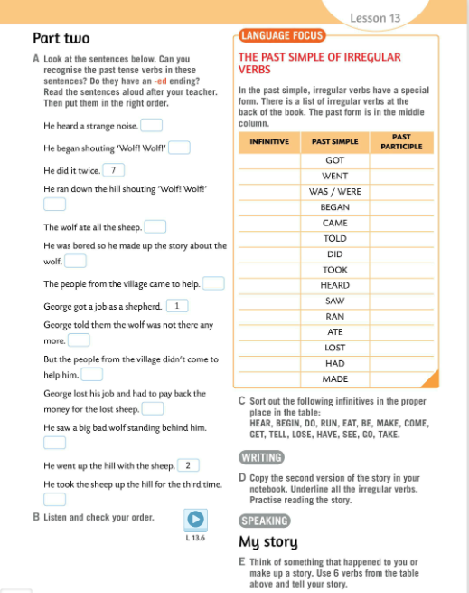
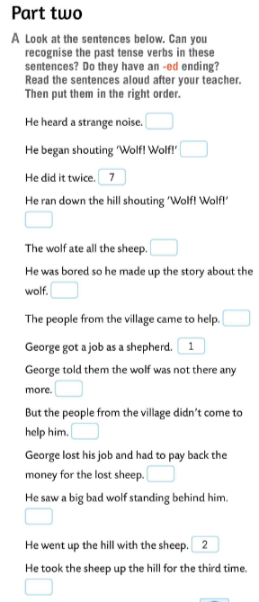
Look at the sentences in Task A.
Can you recognise the past tense verbs in these senteces? Do they have an –ed ending?
Read the sentences aloud after your teacher. Put them in the right order.
9
4
11
13
3
5
Listen and check your answers.
6
12
14
10
8

Slide 15
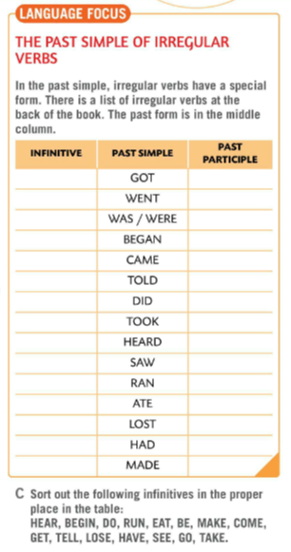
LANGUAGE FOCUS
In the past simple, irregular verbs have a special form.
There is a list of irregular verbs at the back of the book.
The past form is in the middle column.
U glagolskom vremenu past simple postoje nepravilni glagoli, glagoli koji imaju poseban oblik.
Na kraju udžbenika nalazi se lista nepravilnih glagola.
Past oblik glagola nalazi se u središnjem stupcu.

Slide 16
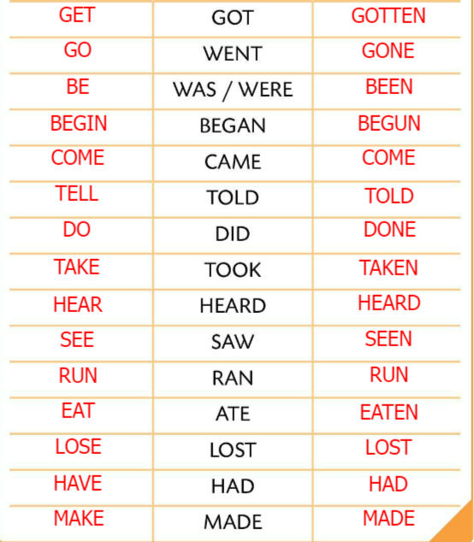
Sort out the infinitives in Task C.
Use the table at the back of your book to help you.
Check.
Copy the second version of the story. Underline all the irregular verbs. Practise reading the story.
Think of something that happened to you or make up a story.
Use 6 verbs from the table and tell your story.

Slide 17
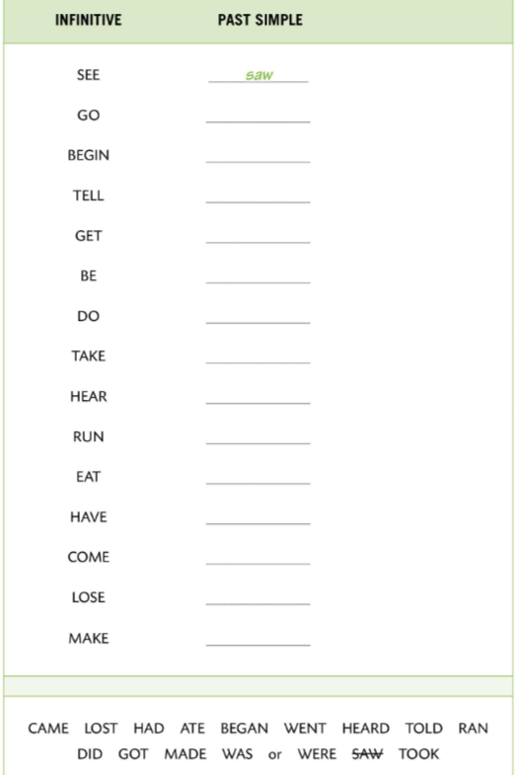
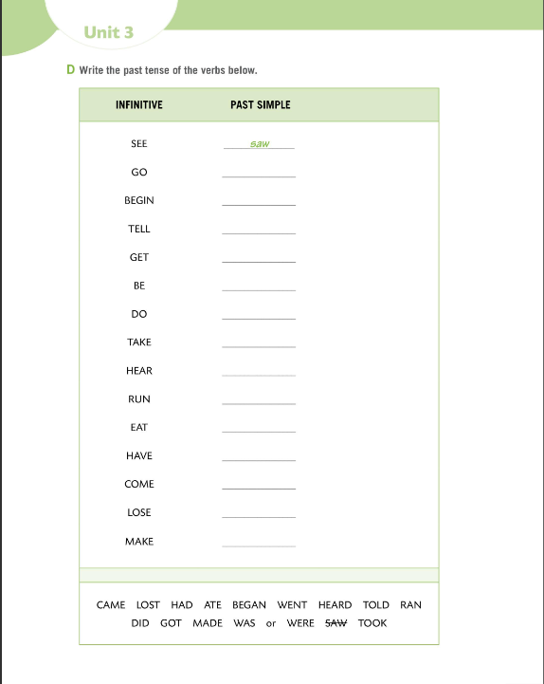
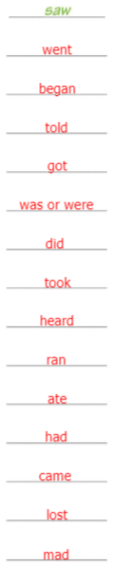
Workbook page 70.
Write the past tense of the verbs below.
Check.

Slide 18
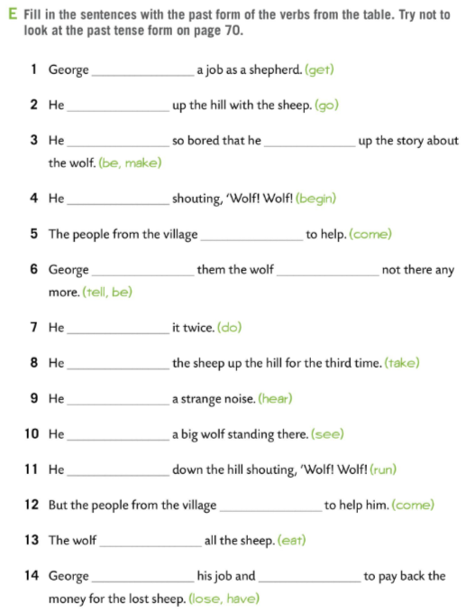
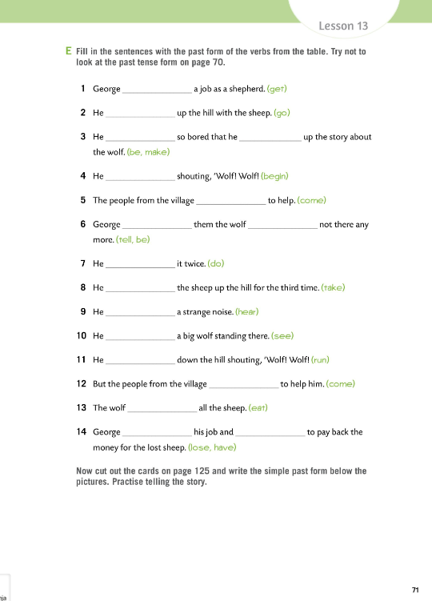
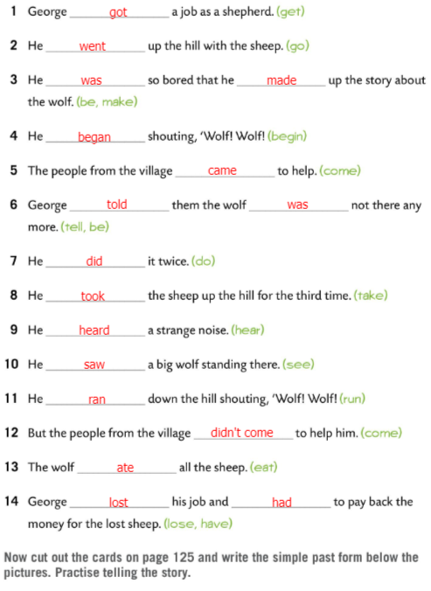
Workbook page 71.
Fill in the sentences with the past form of the verbs from the table. Try not to look at the past tense form on page 70.
Check.
Cut out the cards on page 125 and write the simple past form below the pictures. Practise telling the story.
Play the game and practice past simple!
https://wordwall.net/play/511/114/189

Slide 19
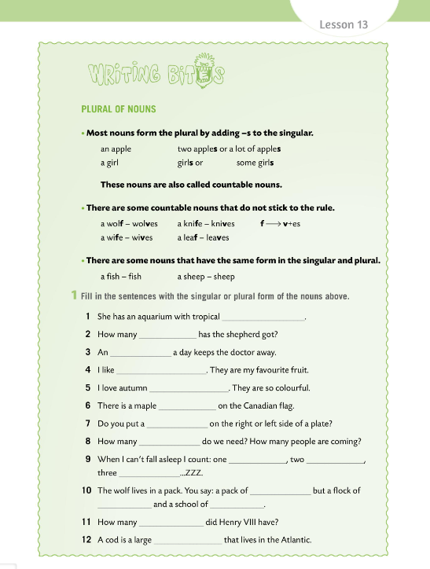
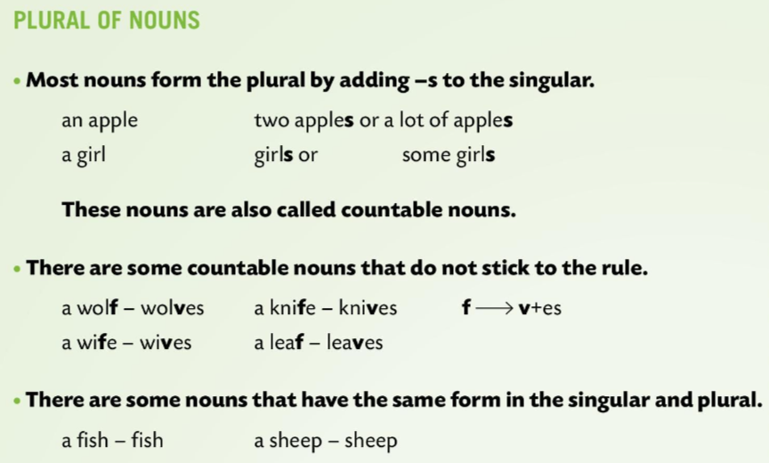
Workbook page 69.
WRITING BITES
Most of the nouns form the plural by adding –s to the singular.
Množina imenica se kod većine imenica tvori dodavanjem nastavka –s.
an apple → two apples or a lot of apples
a girl → girls or some girls
These nouns are also called countable nouns.
Imenice koje imaju pravilnu množinu nazivamo brojivim imenicama.

Slide 20
Workbook page 69.
There are some countable nouns that do not stick to the rules.
Postoje brojive imenice na koje moramo paziti jer su iznimke od pravila.
a wolf → wolves
a kinfe → knives
a wife → wives
a leaf → leaves
f → v + es
There are some nouns that have the same form in the singular and plural.
Neke imenice imaju isti oblik u jednini i u množini.
a fish → fish
a sheep → sheep

Slide 21
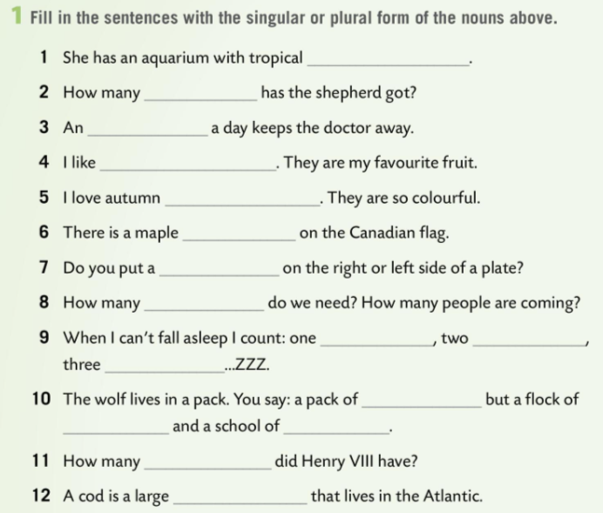
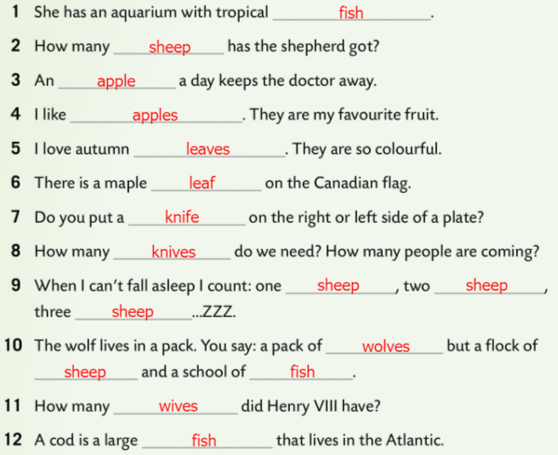
Workbook page 69.
Fill in the sentences with the singular and plural form of the nouns in Task 1.
Check.

